Slide 1
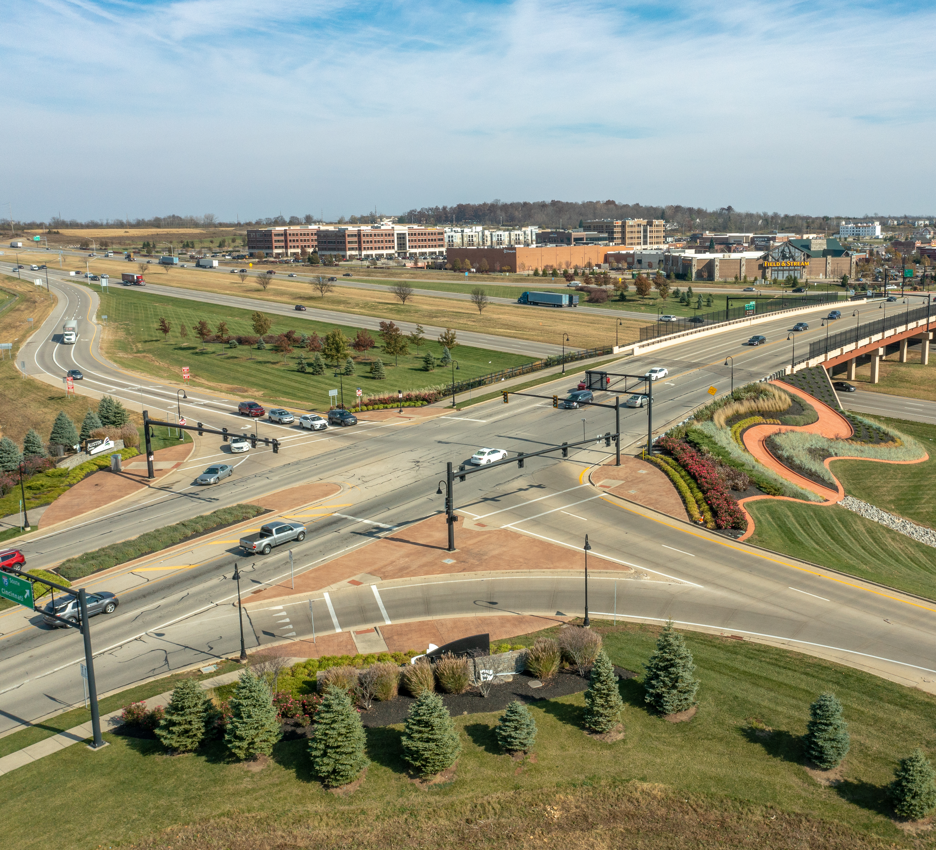
Austin Center Joint Economic Development District
ANNUAL MEETING
DECEMBER 6, 2023

Slide 2

Overview of the District
Support development and redevelopment to create and/or preserve jobs & employment opportunities within the Austin Interchange
Miami Twp. - 57%; Miamisburg – 23%; Springboro – 20%

Slide 3
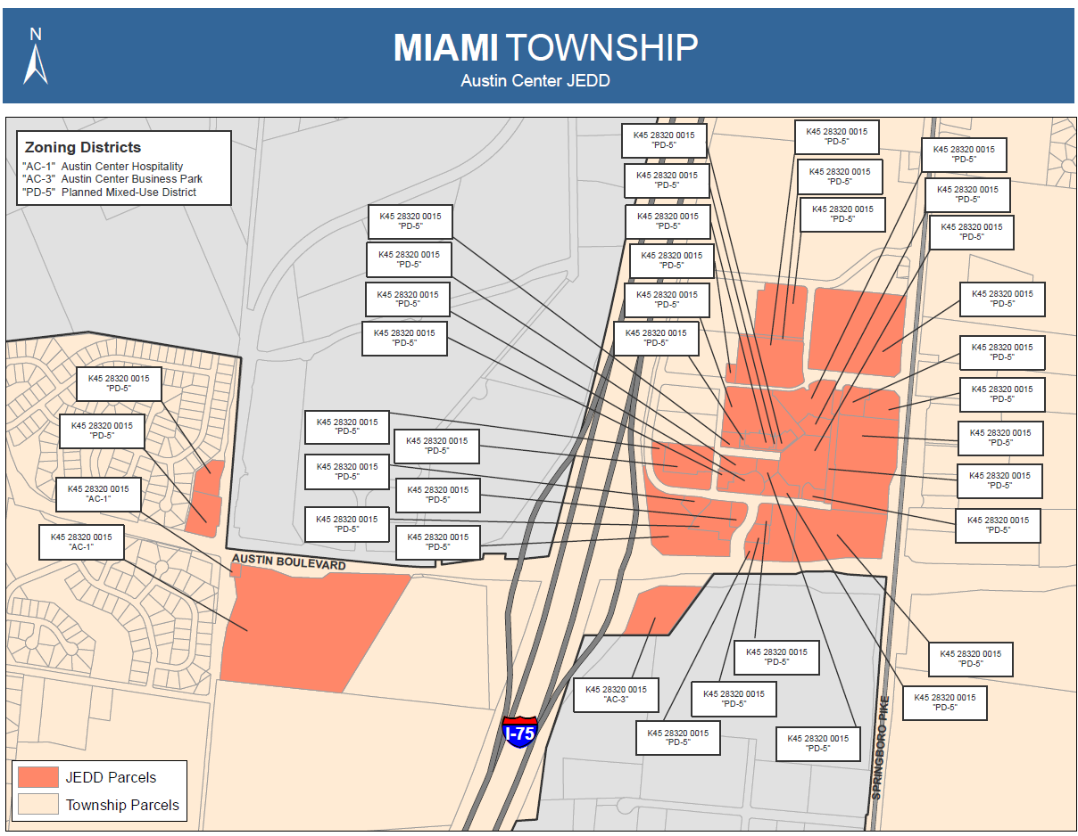

Slide 4
2023 In Review
Continued success of the interchange enhancement maintenance program
Capital items – replaced entry sign letters, irrigation
Retired the District’s SIB Loan (4 years early) for a savings of $32,000.
Authorized the investment of interim funds (up to $750,000) in Star Ohio

Slide 5

2024 BUDGET

Slide 6
2024 Plans for the District
1st class enhancement maintenance program
Assist member jurisdictions and economic development as needed
Develop marketing plan
Continue to address long-term capital maintenance needs
Stamped concrete replacement

Slide 7
Austin Center Joint Economic Development District
ANNUAL MEETING
DECEMBER 6, 2023

