Slide 1

2023 Annual Report
Miami Township • Dayton
Joint Economic Development District

Slide 2
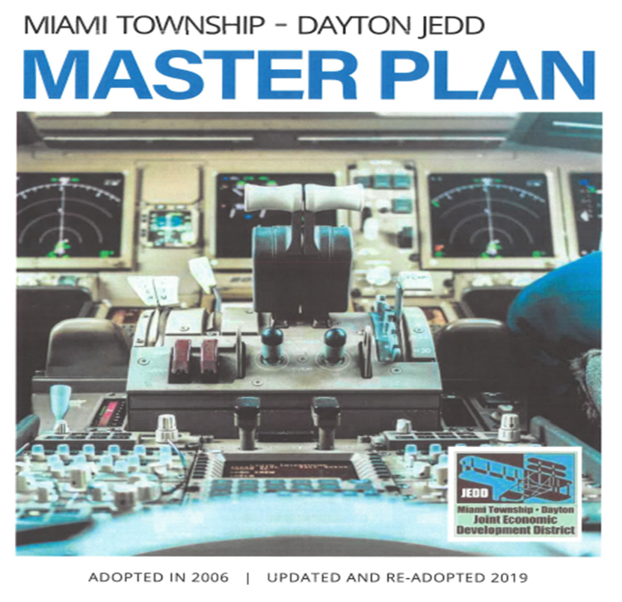
Miami Township • Dayton Joint Economic Development District (JEDD)
The JEDD is in its 18th year!!
Formed in 2005 and amended in 2018, the Miami Township • Dayton JEDD is designed to promote economic development of the Dayton Wright Brothers Airport and other properties along Austin Boulevard and Washington Church Road
The JEDD Master Plan is our guide to implement our mission.
It was created in 2005 and updated & re-adopted in 2019
Formation
2

Slide 3
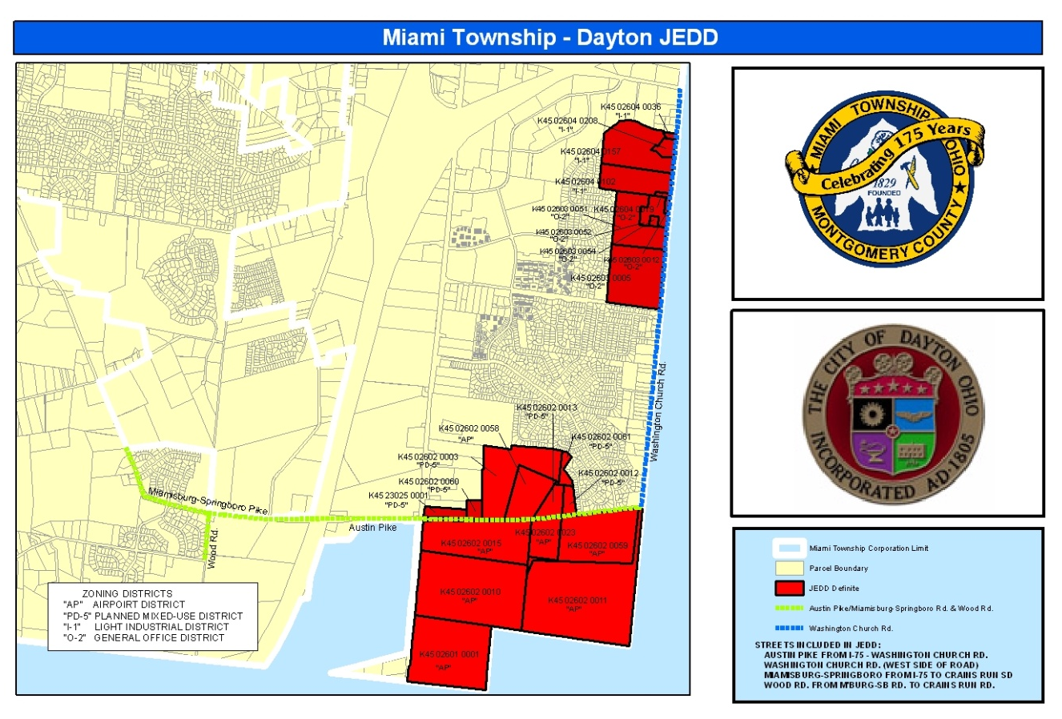
Miami Township • Dayton JEDD
The Contract’s term is through December 31, 2103, and may be renewed.
Currently, there are 12 businesses in the JEDD.
The total area of the JEDD is approximately 655 acres broken down into 7 main properties and 7 property owners.
Location
Notes:
Is 13 right, with Cornerstone?

Slide 4
Primary Benefits
Regional Cooperation
Combined services.
Use of Municipal Charter Powers to regulate speed limits, provide business assistance, etc.
Tax Sharing –
As part of the JEDD agreement, the JEDD implemented an income tax of 1.75% beginning January 1, 2006.
Income tax and property tax will be shared between Miami Township and the City of Dayton (50/50)
Protection from Annexation
Benefits

Slide 5
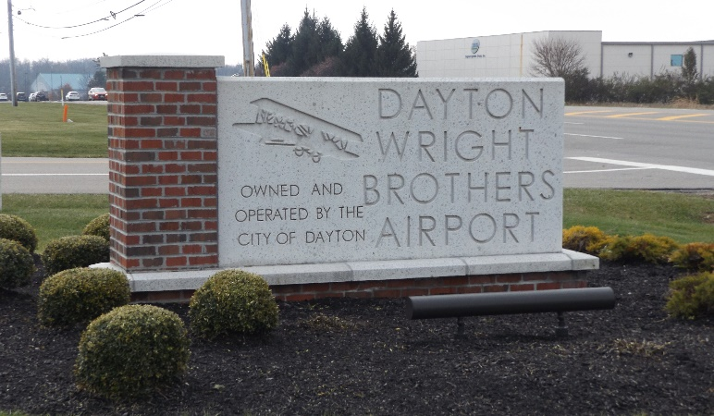
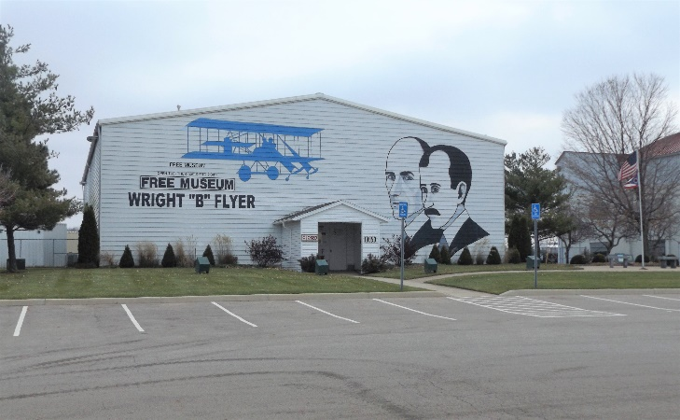
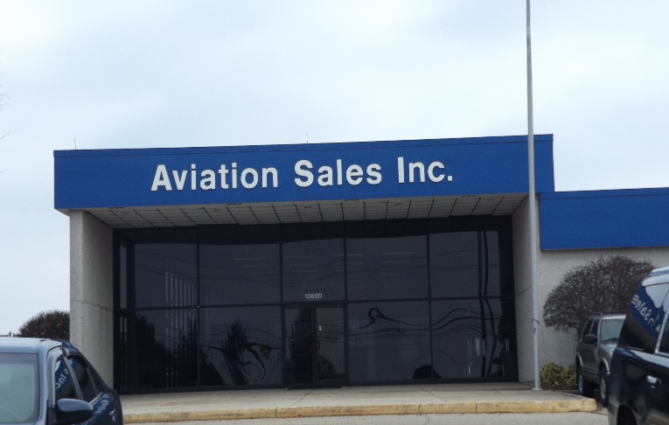
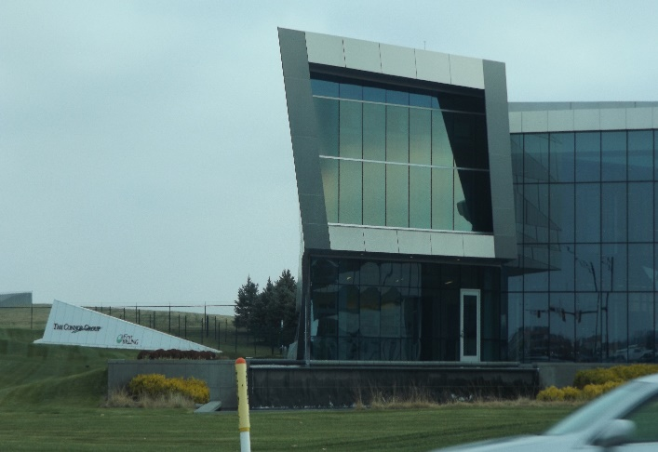


Member Businesses
Fred J. Miller Inc
Wright Brothers Storage Inns
Legacy Ministries Int’l
Dayton Christian Schools
Southbrook Christian Church
Dayton Wright Brothers Airport
First Flight Aviation, Inc
Beavercreek Farms, Inc
Wright B Flyer, Inc
Connor Group
Humane Society of Greater Dayton
Cornerstone Research Group
Members
Notes:
JEDD Business and Property Owners

Slide 6
The Miami Township • Dayton JEDD Board of Directors
The JEDD is governed by a five-member Board:
Chair – Pam Fannin, Sr. Econ. Dev. Spec., Montgomery County
Vice Chair - Mike Cross, Airport Planning and Engineering Manager
Treasurer - Clay McCord, Miami Township
Keith Klein, City of Dayton
Chris Snyder, Miami Township Administrator
Board

Slide 7
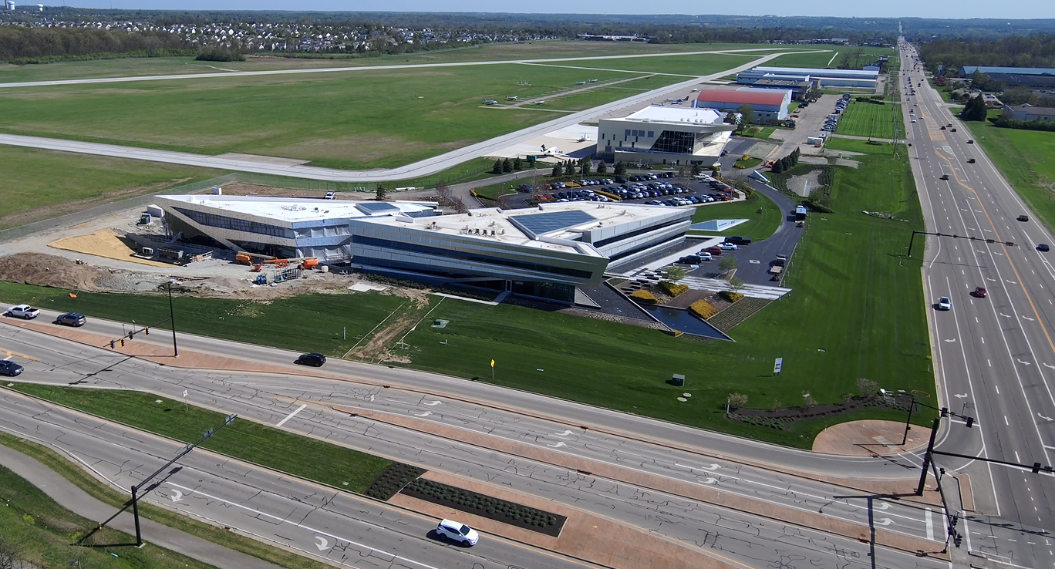
2023 Activity
The Connor Group office expansion – Estimated completion Spring 2024
Activity
7

Slide 8
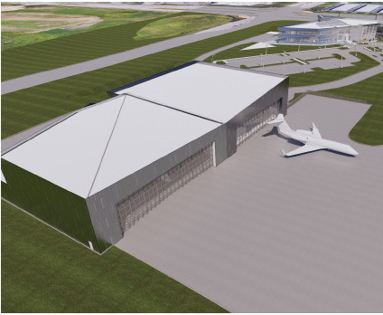
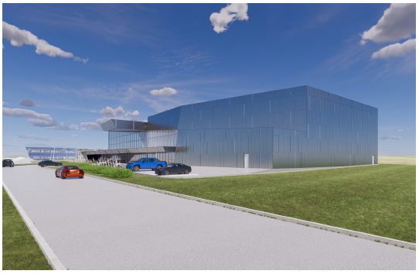
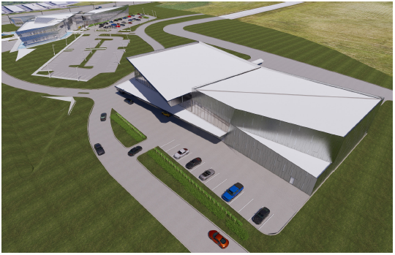
2023 Activity
The Connor Group hangar expansion – Estimated completion Early 2024
Activity
8

Slide 9
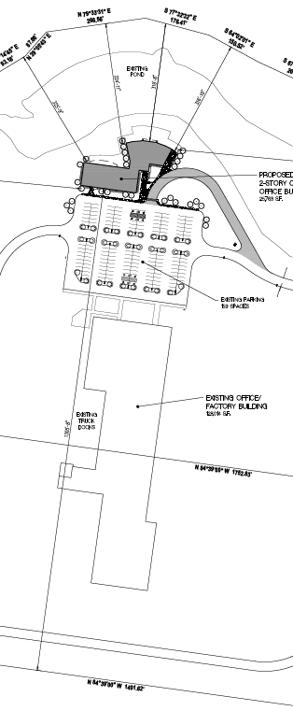
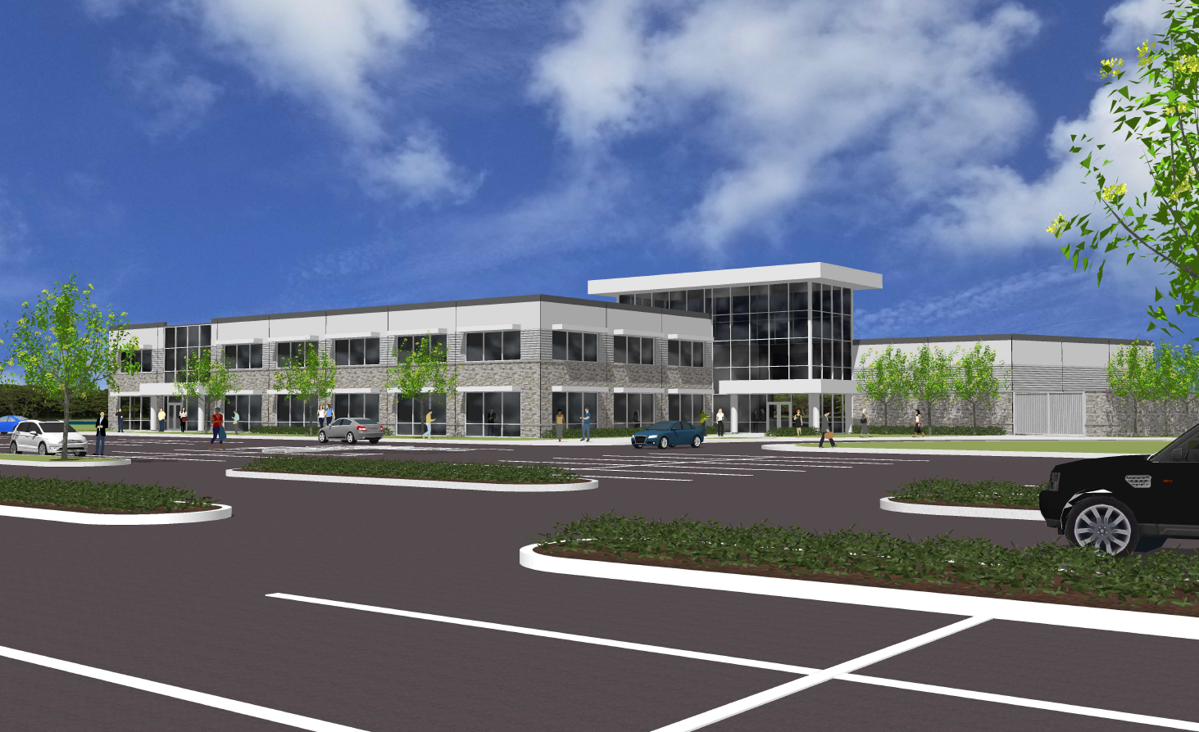

2023 Activity
Cornerstone Research Group new office building approved – Starting construction early 2024
Activity
9

Slide 10
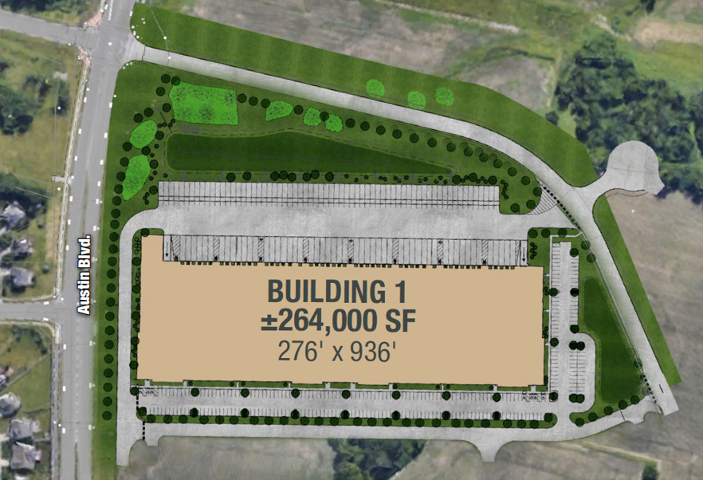
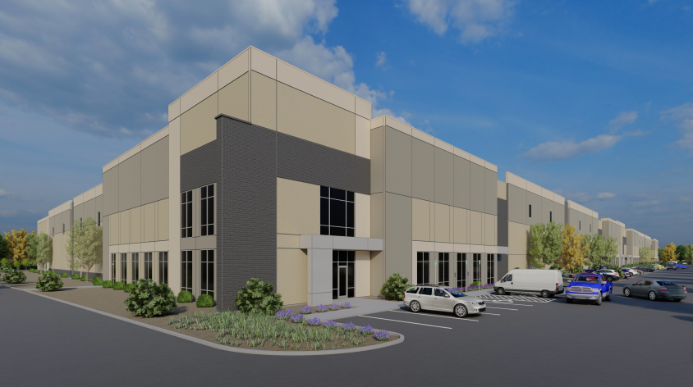
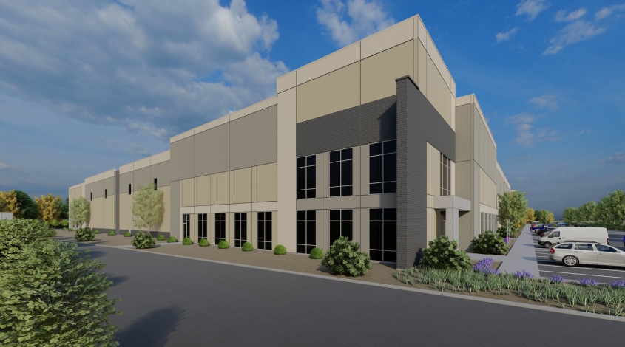
2023 Activity
New industrial park plan approved – First building and roadway extension starting construction early 2024
Activity
10

Slide 11
2023 Action
Approved a contribution of $12,500 to fund the Washington Church Road Extension agreement between Miami Township, Washington Township, Northpoint Development, and the private land owner in Washington Township
The City Airport Administration and Township staff to collaborated to define a pathway for development of Airport land
Township staff met with Dayton Christian Schools to discuss long term site planning and growth of the school
Action
11

Slide 12
2024 Plan
Incentivize additional businesses within the JEDD
Continue discussions between the Department of Aviation and the Township on a path to make property available for development adjacent to the Airport
Work with partners to utilize the Airport to its fullest potential as an economic catalyst for the JEDD
Evaluate the opportunity to assess the current income tax rate
Study the Airport frontage to enhance the 741 corridor
Plan

Slide 13
REVENUES
Income Tax (Q3 collections have not been received from City of Dayton) | $ 401,955
Interest Income | 1,262
Total Revenues: | $ 403,207
EXPENDITURES
2023 Inter-Government Disbursement to Miami Township (based on Prior Year collections) | $ 212,538
2023 Inter-Government Disbursement to City of Dayton (based on Prior Year collections) | 212,538
Liability Insurance | 4,411
Legal Fees & Legal Notices | 854
Audit/Banking Fees | -0-
Meetings & Office Supplies | 200
Maintenance Activities (net of insurance reimbursements) | 250
Prior Year Carry Over Payments (cash basis) | 770
Total Expenditures: | $ 431,561
Net Contribution: (Revenue less Expenditures) | ($28,354)
January 1 - Fund Balance (actual) | $ 1,272,746
December 31 - Fund Balance before Reserves (projected) | 1,244,392
Reserves:
2024 Inter Government Disbursement to Miami Township (based on Current Year collections) | 185,000
2024 Inter Government Disbursement to City of Dayton (based on Current Year collections) | 185,000
Economic Development Assistance & Activities | 70,000
Long Term Maintenance (excludes interest income) (based on Current Year collections) | 19,009
TOTAL RESERVES: | $459,009
Unreserved Fund Balance | $785,383
2023 YTD Financial Summary
As of 11/30/2023

Slide 14
2018 Financial Summary (as of 10/31/18)
REVENUES
Income Tax | $ 493.500
Intertest Income | 30,000
Total Revenues: | $ 523,500
EXPENDITURES
2024 Intergovernmental Disbursement – Mandatory Payment to Miami Township | 100,000
2024 Intergovernmental Disbursement = Discretionary to Dayton | 85,000
Intergovernmental Disbursement – Mandatory to City of Dayton | 100,000
Intergovernmental Disbursement – Discretionary to City of Dayton | 85,000
Economic Development Assistance Payments | 50,000
Economic Development Activities – Runway Fest | 20,000
Liability Insurance | 4,500
Legal Fees/Notices | 5,000
Meetings/Office Supplies | 300
Total Expenditures: | $ 449,800
Net Contribution: (Revenue less Expenditures) | $ 73,700
January 1 - Fund Balance (estimated) | $ 1,244,392
December 31 – Fund Balance (estimated ) - Before Reserves | 1,318,100
RESERVES
2025 Inter-Government Distribution to Miami Township | $ 185,000
2025 Inter-Government Distribution to the City of Dayton | 185,000
Economic Development Assistance & Activities | 70,000
Long-Term Maintenance: excludes interest income | 21,000
TOTAL RESERVES: | $ 461,000
Projected Fund Balance – After Reserves | $ 857,100
2024 Budget-Proposed

Slide 15
* Income tax receipts adjusted to show amounts in year collected versus received.
15

