Slide 1

2023 Annual Report

Slide 2
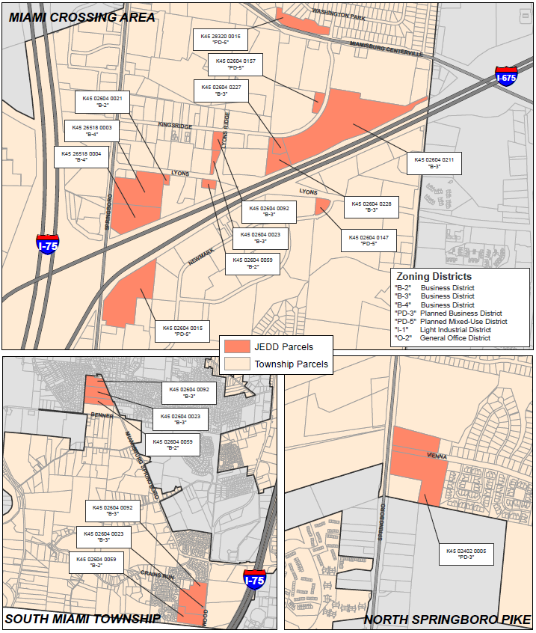
Miami Crossing JEDD
The Contract’s term is through December 31, 2060 and may be renewed.
There are 30 businesses and 5 government facilities in the JEDD.
The total area of the JEDD is approximately 204 acres.
Location
2

Slide 3
Primary Benefits
Regional Cooperation
Use of Municipal Charter Powers to regulate speed limits, provide business assistance, etc.
Contributes funding to projects of importance to the JEDD geography
Tax Sharing –
As part of the JEDD agreement, the JEDD implemented an income tax of 1.75% in August of 2009. The rate was increased to 2.25% beginning January 2011 to maintain consistency with the rate in the City of Miamisburg.
Income tax is shared between Miami Township and the City of Miamisburg (70/30) after the JEDD retains 25%
Protection from Annexation
Benefits
3

Slide 4
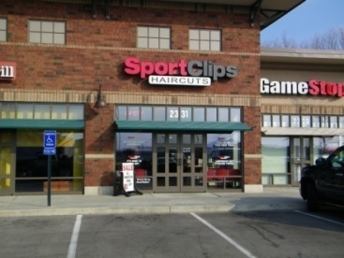
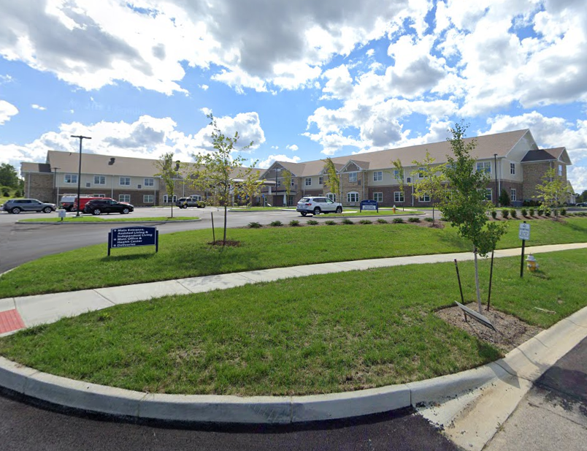
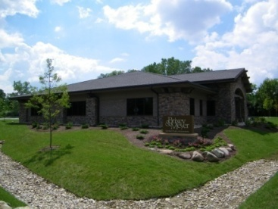
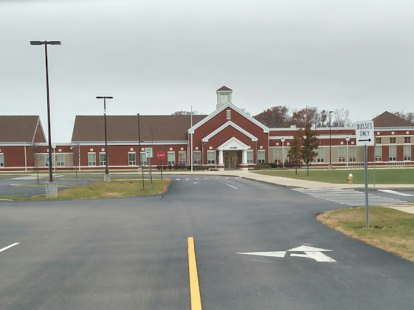
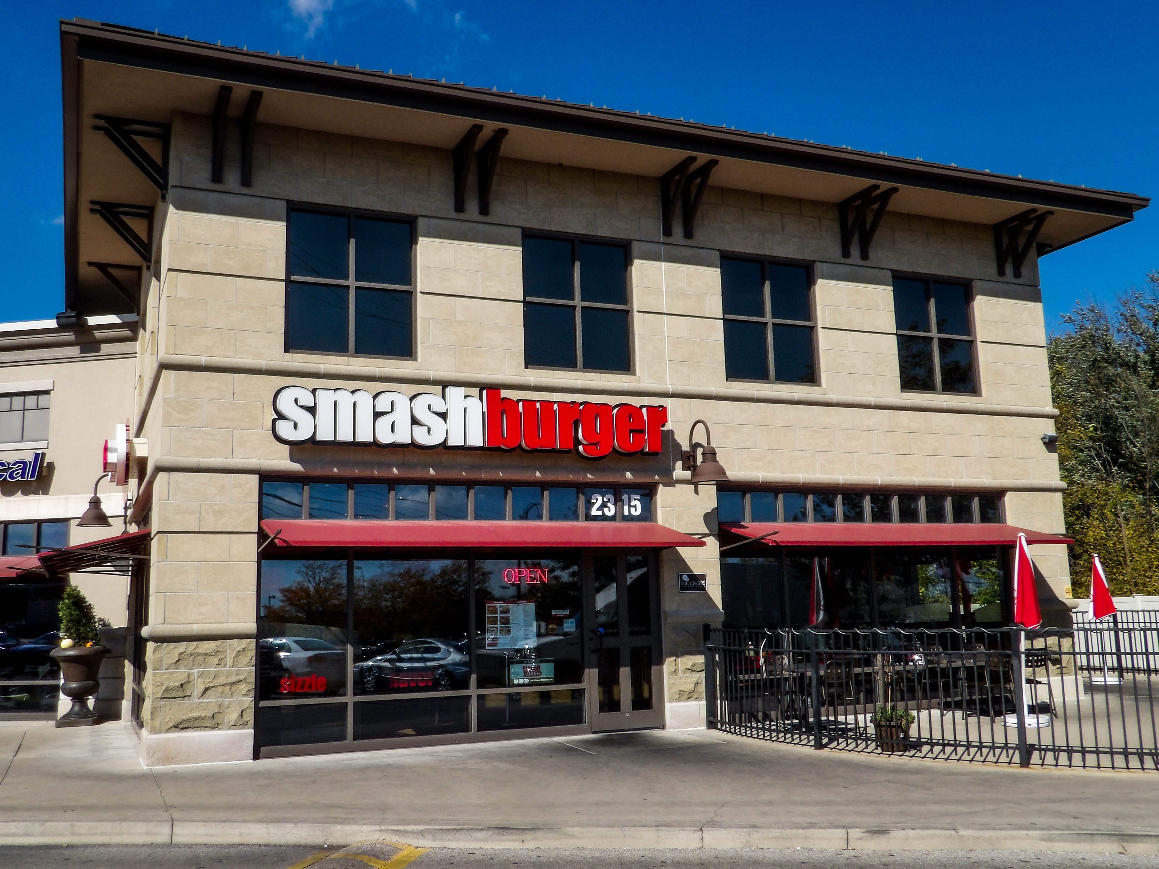
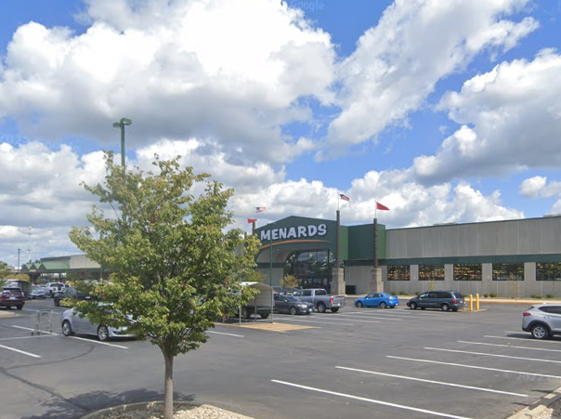
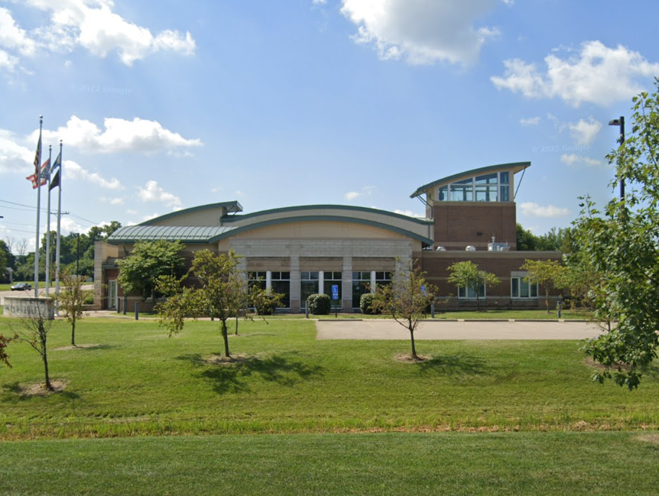
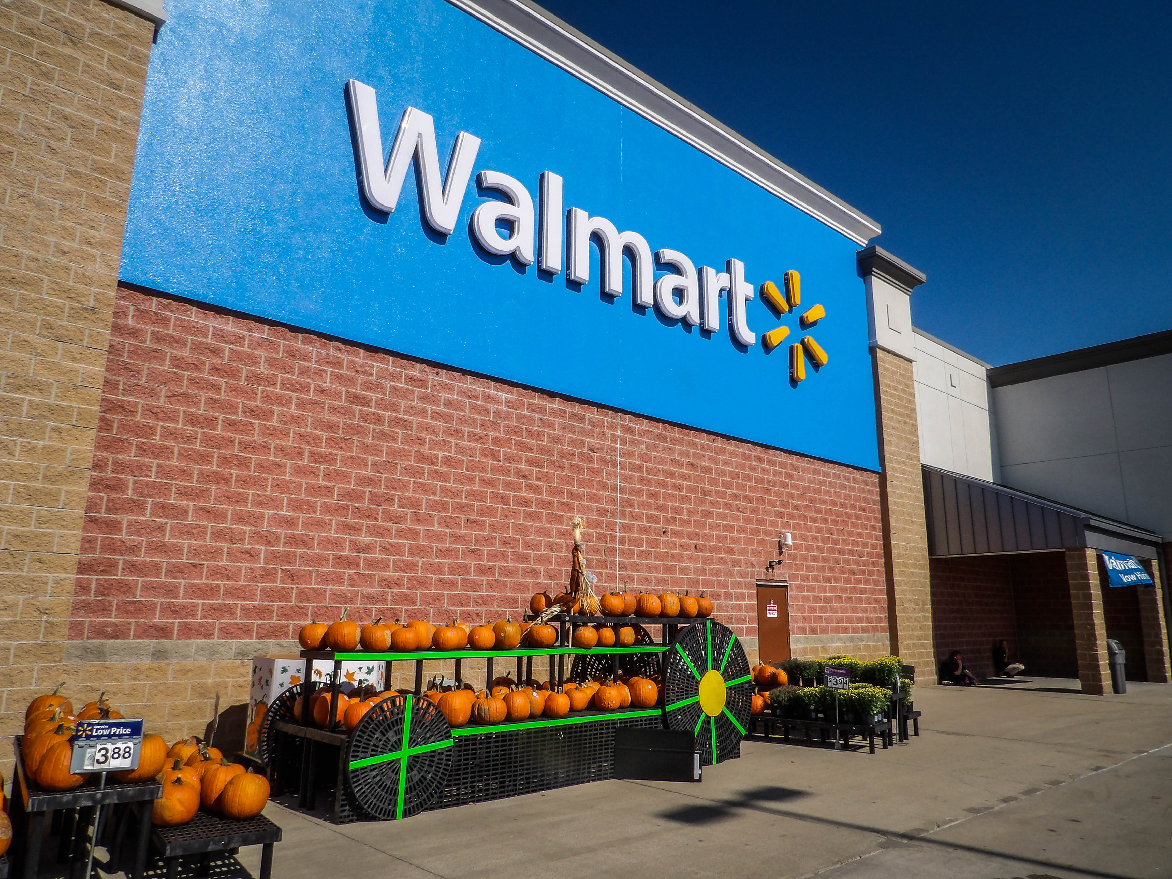
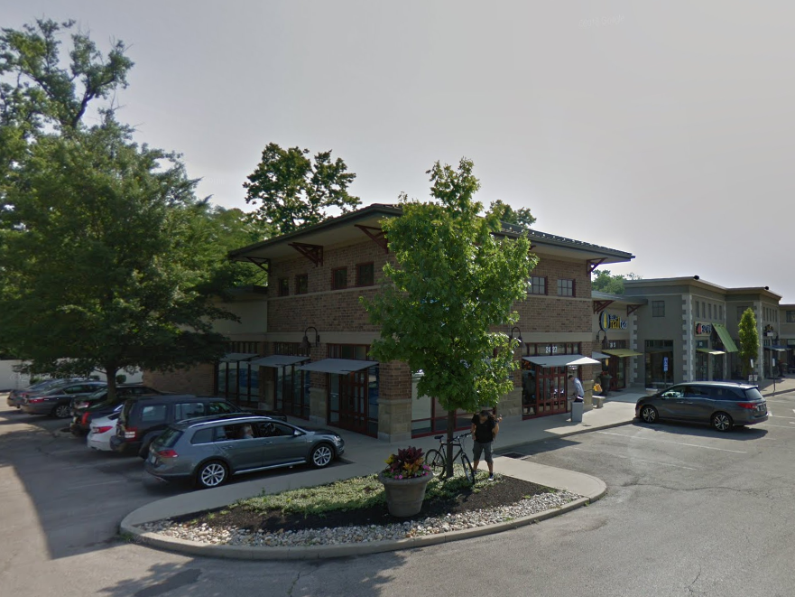
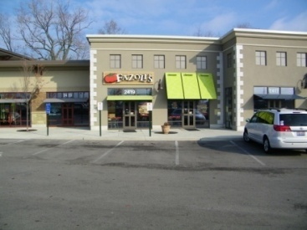
Member Businesses
Brixey & Meyer
Lyons Crossing
King’s Furniture
Menards
Sherwin-Williams
Miamisburg Schools
Jane Chance Elementary
Maddox-Lang Primary School
Miamisburg Middle School
Miami Valley Fire District
Fire Station 51
Fire Station 52
Range USA
Vienna Center
Vienna Springs Health Campus
Village on 725
Bella Nail Bar
Cookie Cutters
GameStop
Jimmy John’s
So Pizza
Shawnee Optical
Smashburger
Smoothie King
Sport Clips
Thai Kitchen
Vitamin Shoppe
Waxxpot
Wal-Mart Supercenter
Subway
Jackson Hewitt
Woodforest Bank
Members
4
Notes:
JEDD Business and Property Owners

Slide 5
Miami Crossing JEDD Board of Directors
The JEDD is governed by a five-member Board:
Chair Tawana Jones, Montgomery County
Vice-Chair Emily Christian, City of Miamisburg
Treasurer Clay McCord, Miami Township
Andrew Rodney, City of Miamisburg
Alex Carlson, Miami Township
Board
5

Slide 6
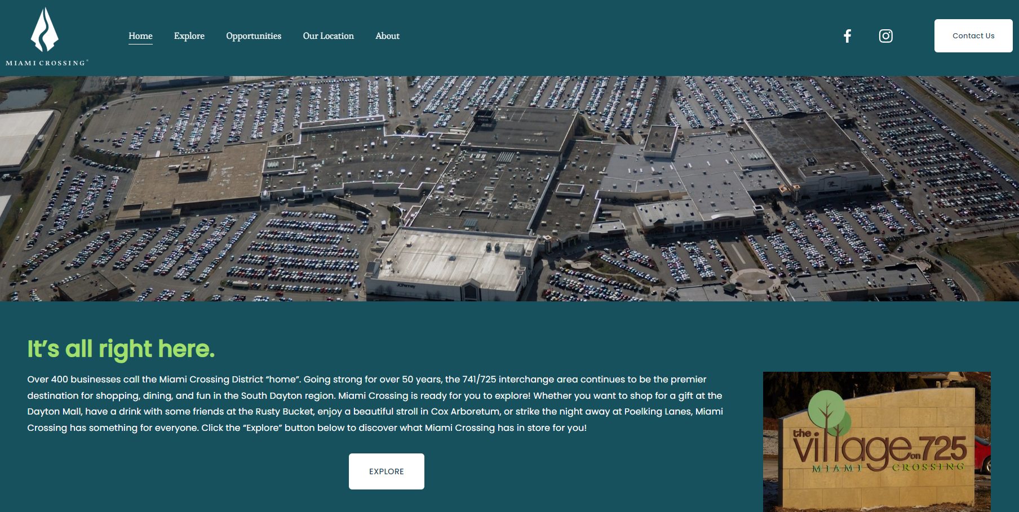
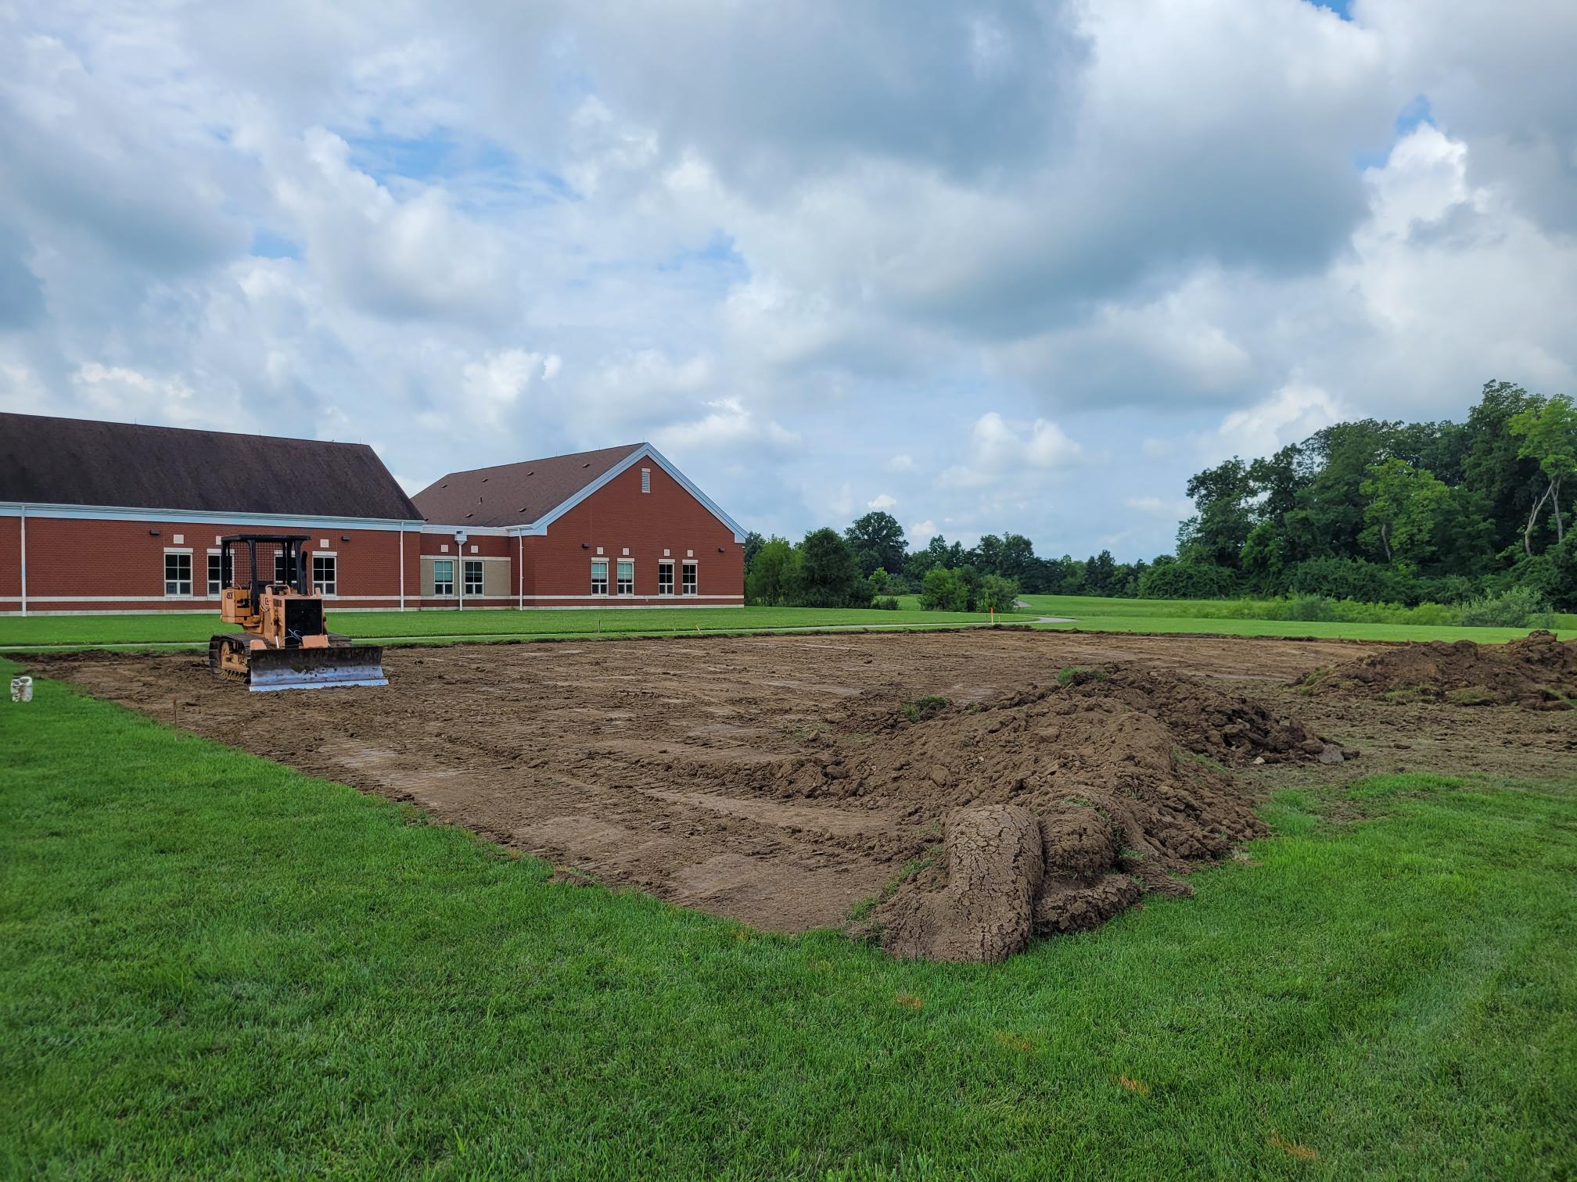
2023 Accomplishments
Cooperation with ODOT on Exit 44 Improvements
Successful application for enhancement project along Kingsridge Drive
Updated Marketing Materials
Initiated a refurbishment of website and formalized economic assistance grant program
Assisted in funding a permanent home for Safety Village at Jane Chance Elementary
Accomplishments
6

Slide 7
2024 Plans for District
Launch revamped Economic Assistance Grant program
Conduct targeted BR&E visits with JEDD and non-JEDD businesses
Finalize proposed improvements to Exit 44
Work with ODOT to prepare preliminary engineering for Kingsridge Drive
Further incorporation of the Miami Crossing branding within the Dayton Mall and around the district.
Help the Miami Crossing District, including the Dayton Mall, redevelop by supporting future changes
2024 Plans
7

Slide 8
REVENUES
Income Tax (Q3 collections have not been received from City of Miamisburg) | $ 1,124,167
Total Revenues: | $ 1,124,167
EXPENDITURES
Inter-Government Disbursement to Miami Township (based on Prior Year collections) | $ 659,125
Inter-Government Disbursement to Miamisburg (based on Prior Year collections) | 282,482
Liability Insurance | 6,315
Legal Fees & Notices | 10,192
Audit/Bank Fees | 201
Meetings/Marketing/Office Supplies/Misc. | 1402
District Development Plans/Maintenance Activities | 109,862
Landscaping (ROW) | 10,208
PY Expenses Paid in January | 11,840
Total Expenditures: | $1,091,627
Net Contribution: (Revenues Less Expenditures) | $ 32,541
Fund Balance (01/01/2023) | $ 2,820,129
Projected Fund Balance (12/31/2023) before Reserves | 2,825,669
RESERVES
Inter-Government Disbursement to Miami Township (based on Current Year collections) | $ 800,188
Government Disbursement to Miamisburg (based on Current Year collections) | 342,938
Local Match Contribution for ODOT Exit #44 Redesign Project | 128,700
Economic Development Assistance Activities | 50,000
Total Reserves: | $1,321,826
FUND BALANCE AFTER RESERVES | $ 1,530,843
2023 YTD Financial Summary
As of 11/30/2023

Slide 9
REVENUE
Income Tax | $ 1,075,000
Total Revenue: | $ 1,075,000
EXPENDITURES
Inter-Government Disbursement to Miami Township (based on Prior Year collections) | $ 563,142
Inter-Government Disbursement to City of Dayton (based on Prior Year collections) | 241,347
Miami Crossing District Development Fund & Development Assistance Payments | 80,000
Economic Development Assistance Payments | 20,000
Liability Insurance | 7,000
Legal Counsel Fees & Notices and Audit Fees | 6,750
Maintenance (ROW, Banners) | 14,000
Meetings/Office Supplies/Misc. | 450
LT Maintenance Reserve Contribution (0.05% of Income) – projected | 5,375
Total Expenditures: | $ 938,064
Net Contribution: (Revenue less Expenditures) | $ 136,936
January 1 - Fund Balance (estimated) | $ 2,852,669
December 31 – Fund Balance (estimated ) - Before Reserves | 2,989,605
RESERVES
2025 Inter-Government Distribution to Miami Township | 710,000
2025 Inter-Government Distribution to the City of Miamisburg | 305,000
Specific Projects (including Development Plans) | 128,700
Development Assistance Activities | 50,000
Total Reserves: | $ 1,193,700
PROJECTED ENDING FUND BALANCE – After Reserves | $ 1,795,905
2024 Budget-Proposed

Slide 10
Income Tax Receipts
2009-Present
10

